Slide 1
From argentina to the war on terror

Slide 2
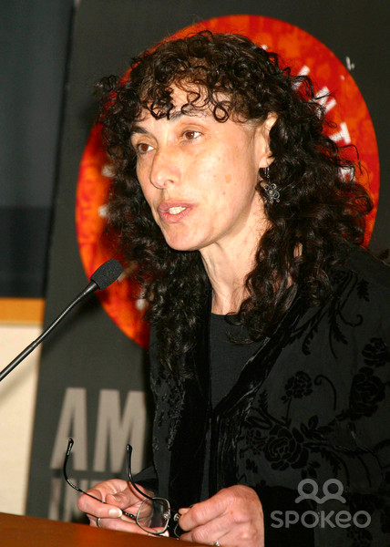
Alicia Partnoy
Detained Jan. 12, 1977 and held for more than two years at various locations
The Little School was the name of the first detention center where she was taken.
Went into exile and lives in the United States

Slide 3
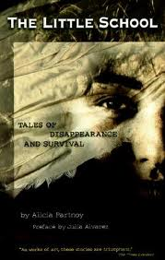
How to tell her story?
Testified before various organizations, including the UN, Amnesty International and Argentina’s National Commission on the disappeared
Writes fiction and poetry

Slide 4
Testimony -- Testimonio
(testimonial fiction)
“Testimony” is personal or documentary evidence attesting to a fact. It is a legalistic term associated with witnessing.
“Testimonio” is a genre of fiction based on actual events and sometimes told by a witness
Intertextual dialogue of voices that reorders historical events in narrative form

Slide 5

Rain and freedom
“The smell of damp earth made her come to grips with the fact that she was still alive. She inhaled deeply and a rare memory of freedom tickled her cheekbones. The open window let some rain in.”

Slide 6
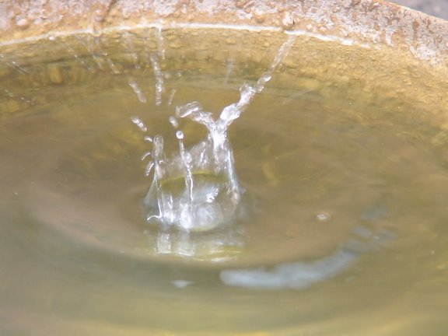
Containing the rain
“The first four cans were making the sweetest music she had heard in a very long time…She stretched out her hand and the drops found a place in her palm…five little pools of freshness and life among all that dirtiness.

Slide 7
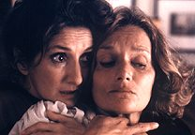
Confronting the Dirty War
Military officials on trial.
National commission investigated the disappeared, published report.
Ongoing social discussion.
Films and books

Slide 8
Views of History –
The Official Story
Argentina’s 19th Century
Argentina’s Dirty War
Narrative from textbooks.
What is left out?
How are major figures conceived and framed?
How to write alternate history?
“Official story” by the government
What is not told? What happened to the disappeared?
What do people ignore or overlook?
How to respond w/ an alternate perspective?

Slide 9
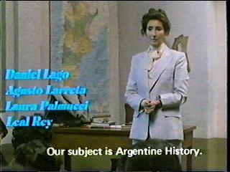
Writing History
Student: “History is written by assassins.”
Role of textual evidence in writing history?
Believing official stories?
What is unknown?

Slide 10
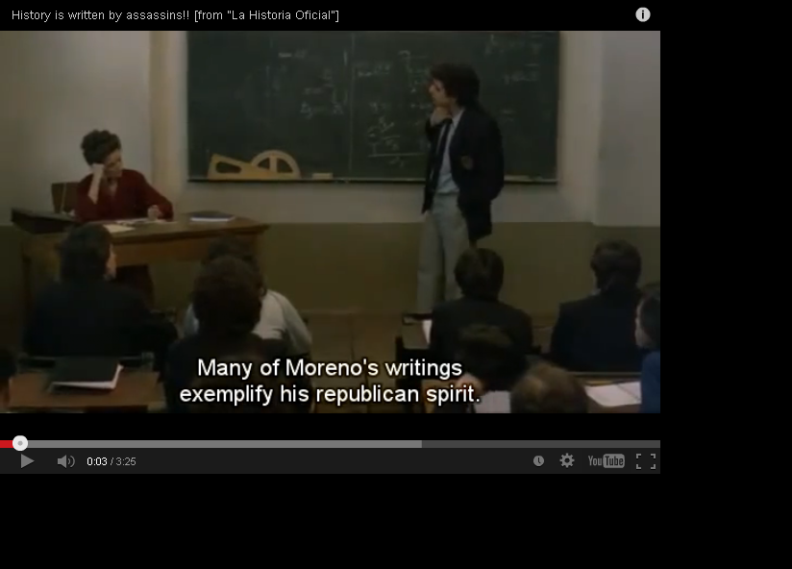
http://www.youtube.com/watch?v=xk8oMyNMsyM
Notes:
Video frame is visible in slideshow mode.

Slide 11
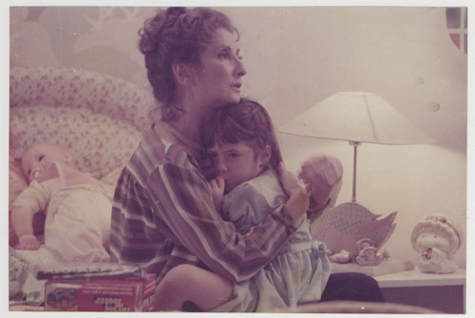
Role of Memory?

Slide 12
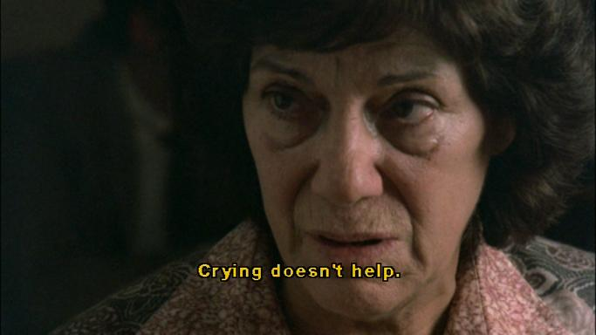
Motherhood?
Alicia as mother figure who lost her own mother
Mothers of the disappeared
Biological parents and adoption

Slide 13
Searching for truth
Meeting with the priest. “I don’t need absolution. I need the truth.” (Role of Catholic church)
Meeting with the other teacher. Benitez: “It’s always easier to believe it’s impossible, right?” (Educational institutions)
Meeting with the Mothers of the Plaza de Mayo. “It’s important to remember.” (Civic participation)
Role of newspapers, photography, and memory.

Slide 14
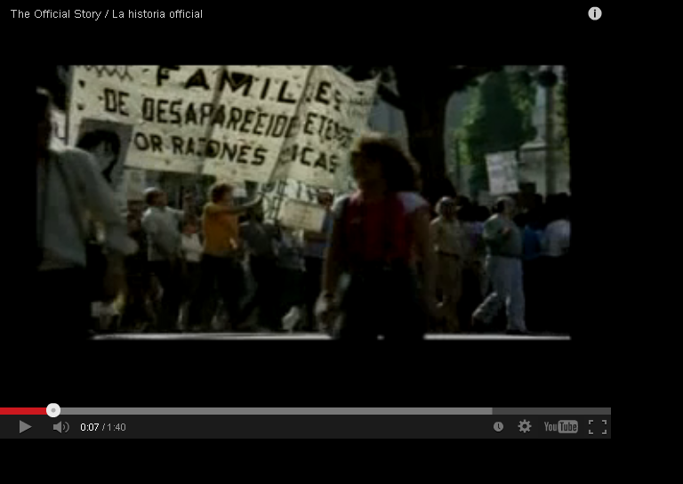
http://www.youtube.com/watch?v=g7LF5II0wIY

Slide 15
Truth about her husband, class and status
Works for a high-powered company
His job allows them to have an upper middle class lifestyle and the adopted daughter
Her family structure sets up privilege
“The foreign debt and the corruption…

Slide 16
Multinational business
Roberto works in a confusing world of business ventures. Travels outside the country.
Connections to the military government
Questions about corruption
Associate disappears
Co-workers from the United States or Europe
Roberto’s family questions the ethics of his work

Slide 17
What is the connection between business and the disappeared?
Military rule in Argentina, Chile, and other countries in the 1970s
Free-market business policies; in Chile supported by Milton Friedman
Crisis created by the coup and subsequent human rights violations went hand in hand with crisis necessary for economic shock.

Slide 18
State Terror and Ideology
SHOCK
UNFETTERED MARKET
  Human rights violations.
  Military attack
  Torture sites
Cuts in government services, including education
International companies
Decrease in regulation of businesses

Slide 19
The Shock Doctrine
Naomi Klein on the past four decades:
“Some of the most infamous human rights violations of this era, which have tended to be viewed as sadistic acts carried out by antidemocratic regimes, were in fact either committed with the deliberate intent of terrorizing the public or actively harnessed to prepare the ground for the introduction of radical free-market ‘reforms.’” (11)

Slide 20
Torture as Metaphor
“From Chile to China to Iraq, torture has been a silent partner in the global free-market crusade. But torture is more than a tool used to enforce unwanted policies on rebellious peoples; it is also a metaphor of the shock doctrine’s underlying logic.” (19) – Klein, The Shock Doctrine

Slide 21
Long View of History
Argentina and the War on Terror not as isolated acts
A continuum of war actions tied to global changes in the late 20th and early 21st century
Torture as integral to Dirty Wars, a process that brings together violence and signification

